Slide 1
Surviving in a Digital World
Ian Galloway
T3 Europe STEM lead
T3 Netherlands
Ede 2016

Slide 2
The Matrix

Slide 3
For the whole of Recorded History

Slide 4
To the present day

Slide 5
Bits or Pits

Slide 6
Education
Young people have an entitlement to have some knowledge of how their digital world is constructed.
It is they who will have to grow up and survive in it.
It is from the ranks of young people today that the engineers and designers of tomorrow will come from.
Industry right across Europe is complaining about the lack of engineers, right now.

Slide 7
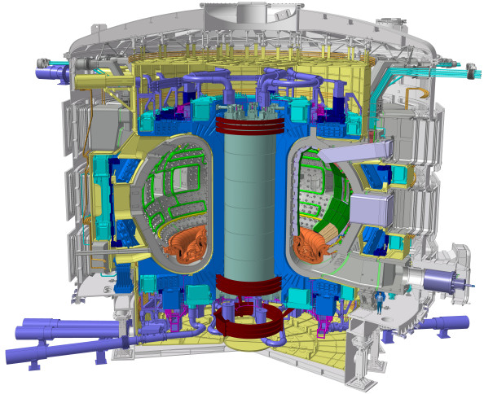
The Big Challenges
ITER:
the Divertor.

Slide 8
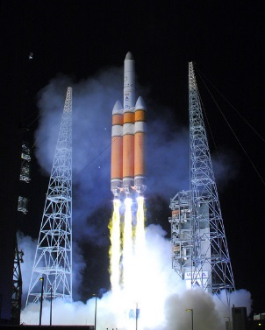
The Big Challenges
Mission to Mars:
the orbit

Slide 9
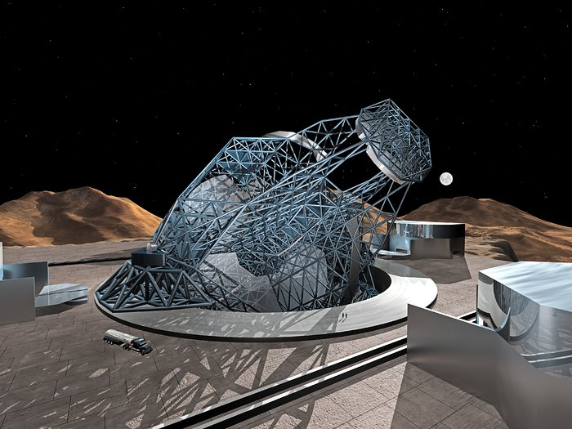
The Big Challenges
Owl:
adaptive optics

Slide 10
The Big Challenges
Genomics
Water
Food
Air
Climate Change

Slide 11
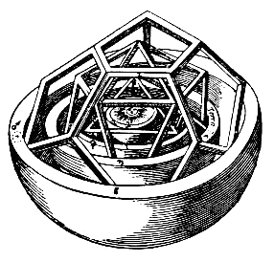
"My dear Kepler, what would you say of the learned here, who, replete with the pertinacity of the asp, have steadfastly refused to cast a glance through the telescope? What shall we make of this? Shall we laugh, or shall we cry?"
--Letter from Galileo Galilei to Johannes Kepler

Slide 12
Digitisation
of Pictures
of Audio
of All measurable quantities
Quantisation
This is Science

Slide 13
Visualisation
Logic
Algorithms
Coding
Display
This is Mathematics

Slide 14
STEM
[nature] cannot be read until we have learned its language….it is written in mathematical language…
Galileo Galilei Il Saggiatore
Understanding the mathematics of nature and then being able to digitise and write algorithms allows us to construct codes which control the technology all around us.
We live in the digital age and as well as being able to code…
There is a need for STEM literacy for survival in this digital world

Slide 15
Coding
Digital technology is all around us.
Coding is key to having access to digital technology.
All young people should have access to coding …a moral right?
Coding allows all digital technologies to be controlled.
It requires an integration of science and mathematics to find engineering solutions.
STEM literacy is key to survival in this digital world.

Slide 16
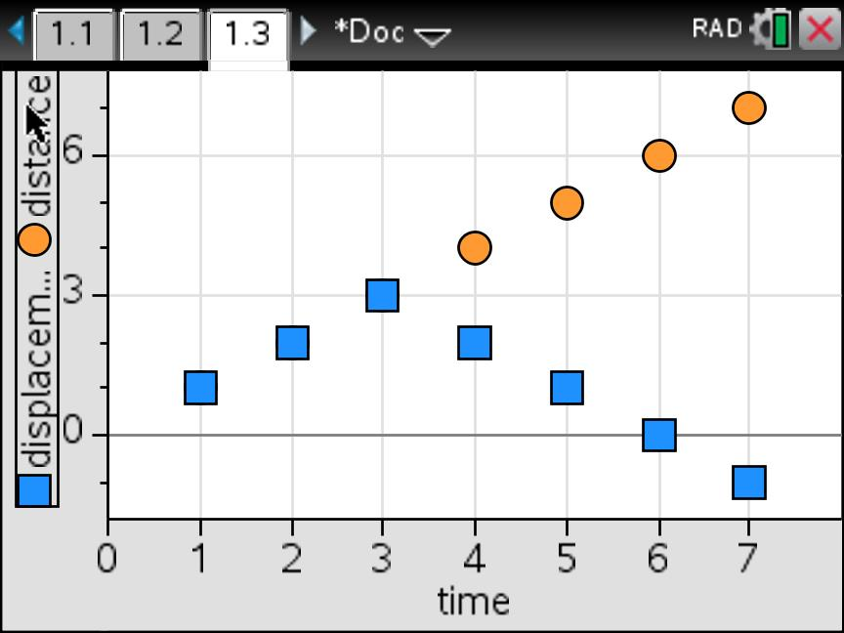
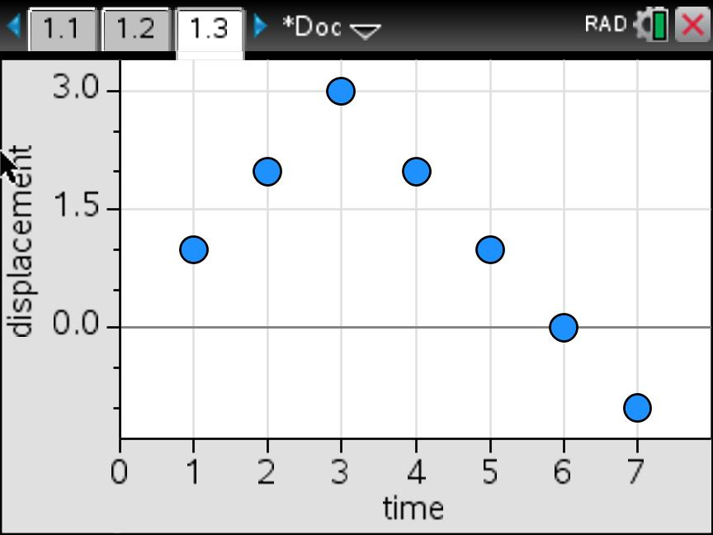
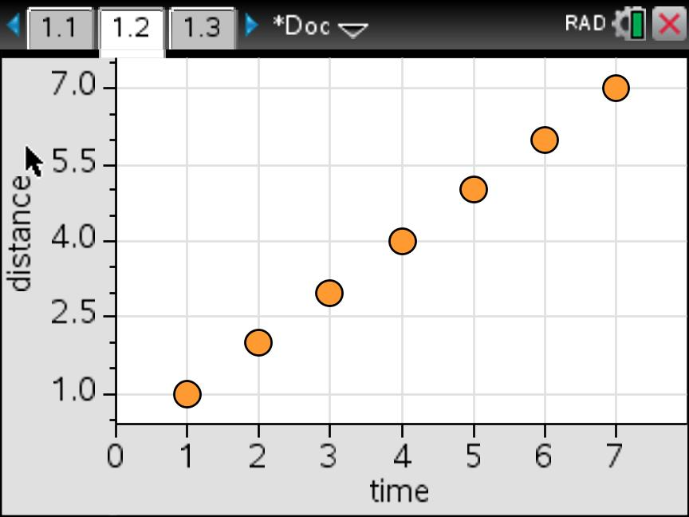
Before you go!
An example of how a STEM approach can lead to greater understanding.

